Slide 1
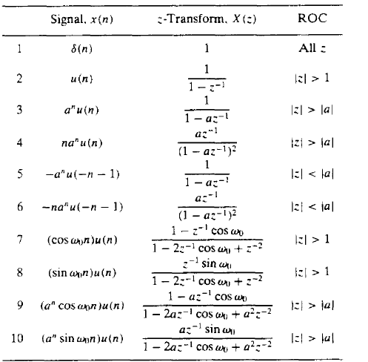
Signal Processing
Lec. 5
The Z-Transform And Its Application To The Analysis Of LTI Systems
5.1 Definition of Z.T The z-transform is a very important tool in describing and analyzing digital systems. It also offers the techniques for digital filter design and frequency analysis of digital signals. The z- transform of a causal sequence x(n), designated by X(z) or Z(x(n)), is defined as:
(5.1)
Where, z is the complex variable. Here, the summation taken from n = 0 to n = ∞ is according to the fact that for most situations, the digital signal x(n) is the causal sequence, that is, x(n) = 0 for n ≤ 0. For non- causal system, the summation starts at n = -∞. Thus, the definition in Equation (5.1) is referred to as a one- sided z-transform or a unilateral transform. The region of convergence is defined based on the particular sequence x(n) being applied. The z-transforms for common sequences are summarized below:

Slide 2
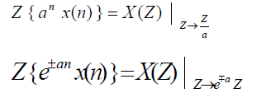
Signal Processing
Lec. 5
5.2 Properties of Z.T:
1- Linearity: The z-transform is a linear transformation, which implies
Where a and b are constants
2- Shift theorem (without initial conditions): Given X(z), the z-transform of a sequence x(n), the z- transform of x(n - m), the time-shifted sequence, is given by;
3- Convolution: Given two sequences x (n) and x (n), their convolution can be determined as follows:
1 2
4- Multiplication by exponential:
5- Initial and final value theorems:
6- Multiplication by n:

Slide 3
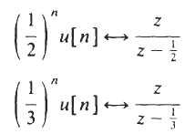
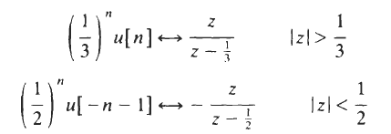
Signal Processing
Lec. 5
Example 1:A finite sequence x [ n ] is defined as: sol:
Example 2: Find the z-transform X(z) for each of the following sequences:
Sol: (a)
(b)
Example 3: Compute the convolution x(n) of the signals by using Z-transform

Slide 4
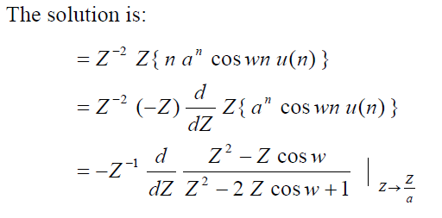
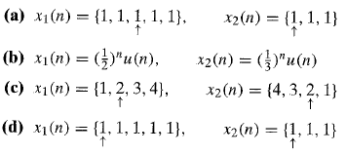
Signal Processing
Lec. 5
Sol:
Example 4:
H.W: Compute the convolution of the following pair of signals by using the z-transform.
5.3 Inverse of Z.T
The inverse z-transform may be obtained by the following methods:
Using properties.
Partial fraction expansion method.
Residue method.
Power series expansion (the solution is obtained by applying long division because the

Slide 5
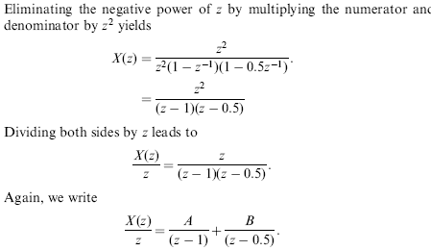
Signal Processing
Lec. 5
denominator can't be analyzed. It is not accurate method compared with the above three methods)
Example1: Find x(n), using properties , if
Solution:
Example(2): Find x(n) using partial fraction method , if:
Solution:

Slide 6
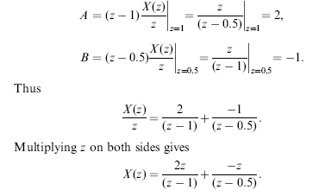
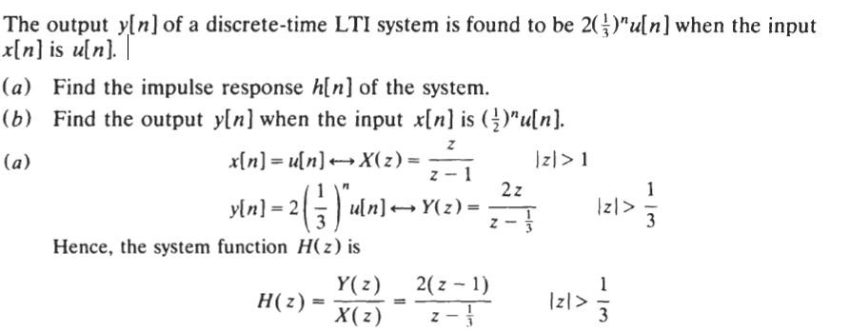
Signal Processing
Lec. 5
H.W: Determine the signal x(n) with z-transform
Example 3:

Slide 7
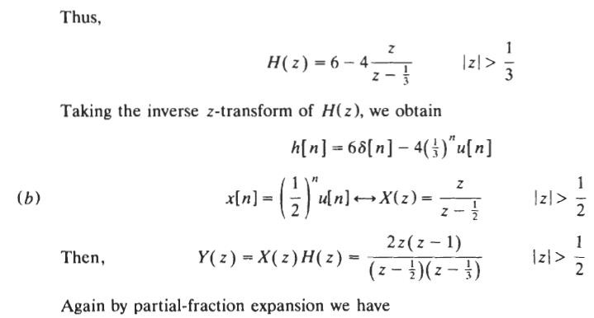
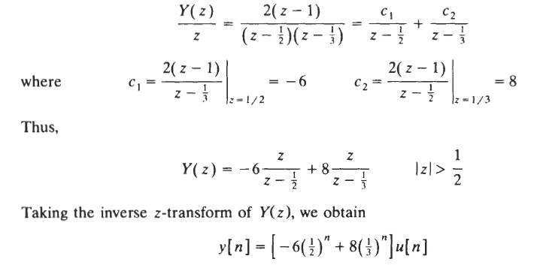
Signal Processing
Lec. 5
H.W: Consider a discrete-time LTI system whose system function H(z) is given by

